Slide 1
21AIE101 ELEMENTS OF COMPUTING - 1
TERM PROJECT
B-12

Slide 2
Group Members
01
02
03
04
CB.EN.U4AIE21177
CB.EN.U4AIE21103
CB.EN.U4AIE21160
CB.EN.U4AIE21123
Abhinav Vura
Sai Praneeth Reddy
Sanjay Chidambaram
Kishoar Hari

Slide 3
Contents
Part A
Part B
Implementing a Hack Computer
16 Bit Parallel Adder

Slide 4
A
Hack Computer

Slide 5

Part A
Q. The implementation of the hack computer must be shown in the hack platform. Moreover, the CPU built must be shown as a part of the hack computer and tested using machine-level programs.

Slide 6
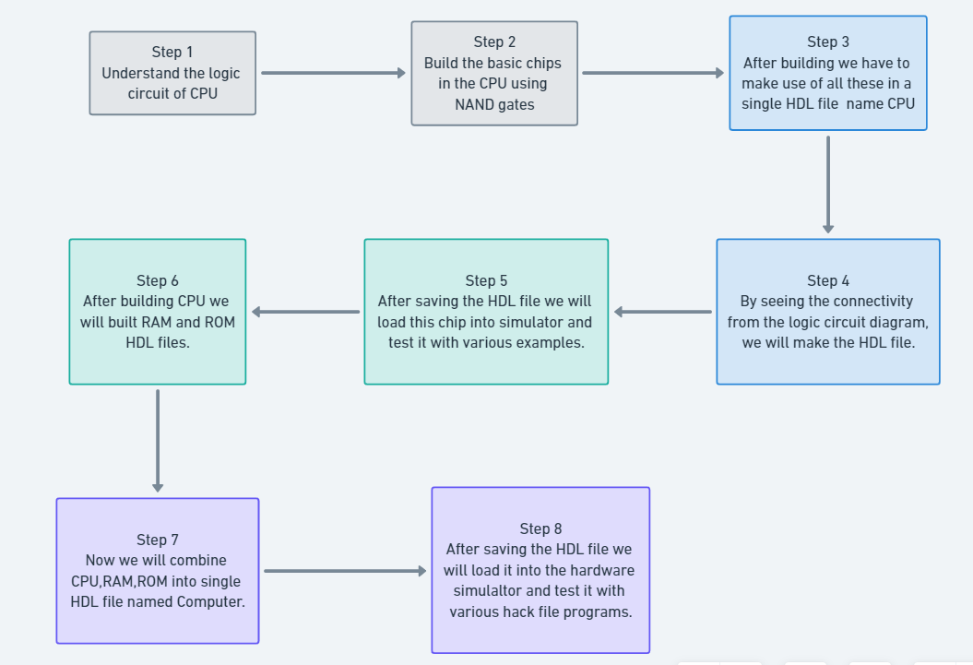
Steps to do…..

Slide 7
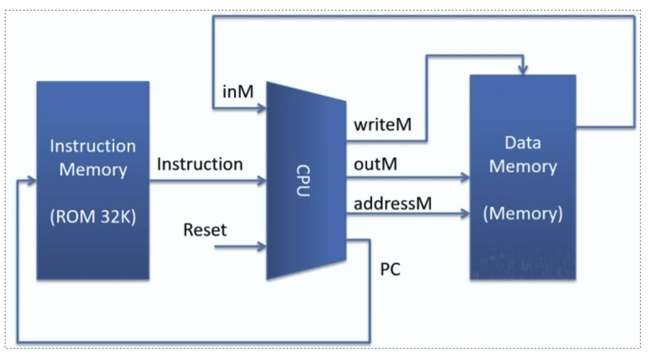
Hack computer

Slide 8
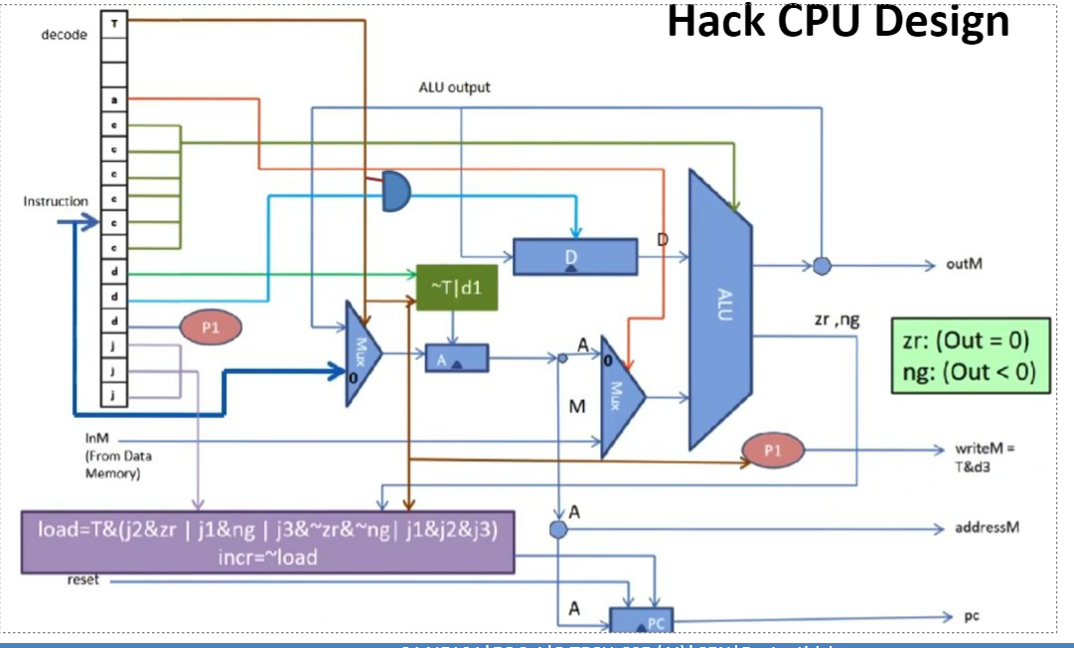
CPU circuit

Slide 9
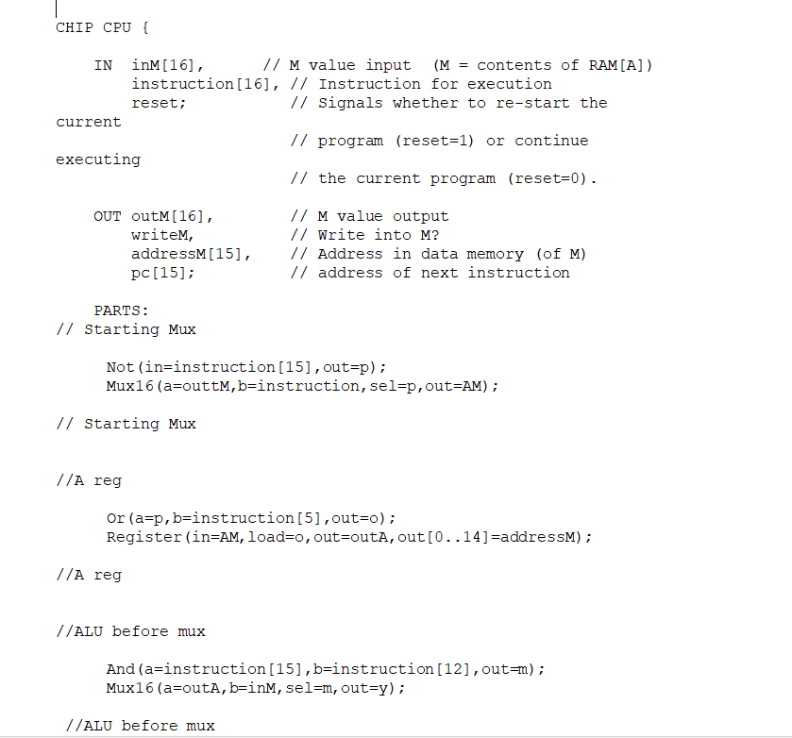
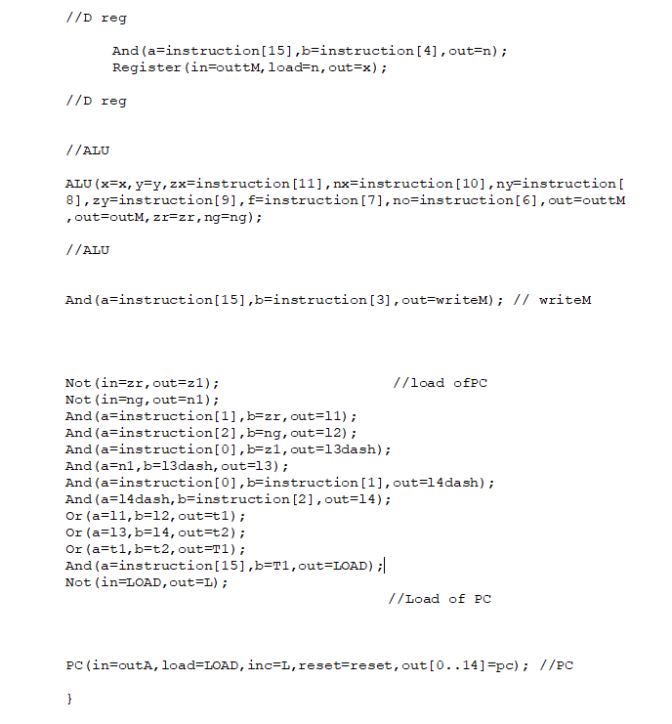
CPU HDL file

Slide 10
Internal gates used to built CPU
And
Not
Or
Add 16
Or 8 way
Mux 16
And 16
Not 16
Program counter
16 bit registers

Slide 11
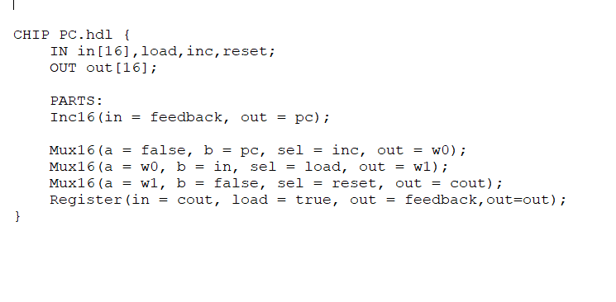
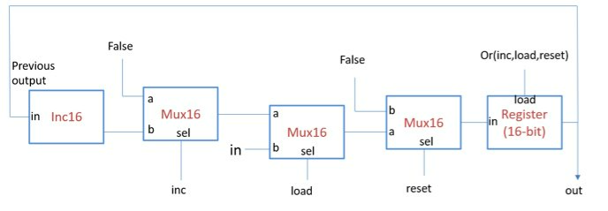
Program counter

Slide 12
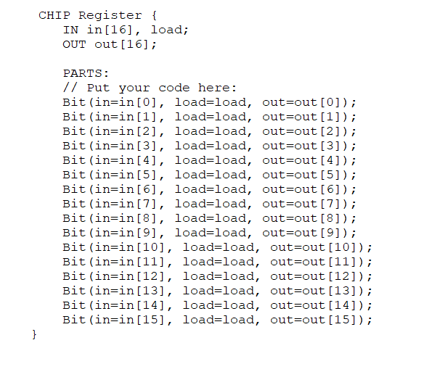
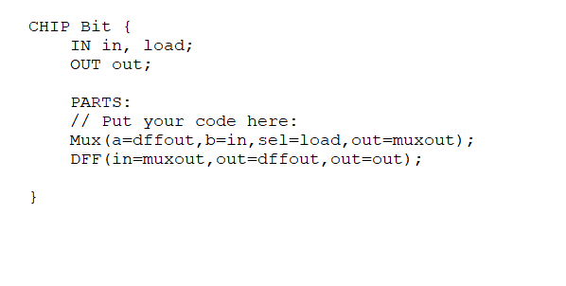
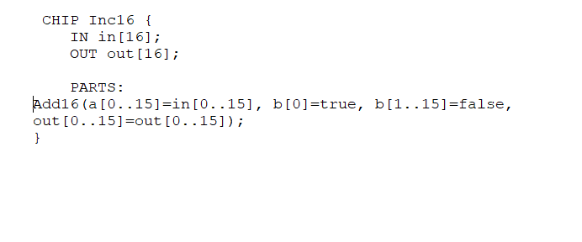

Slide 13
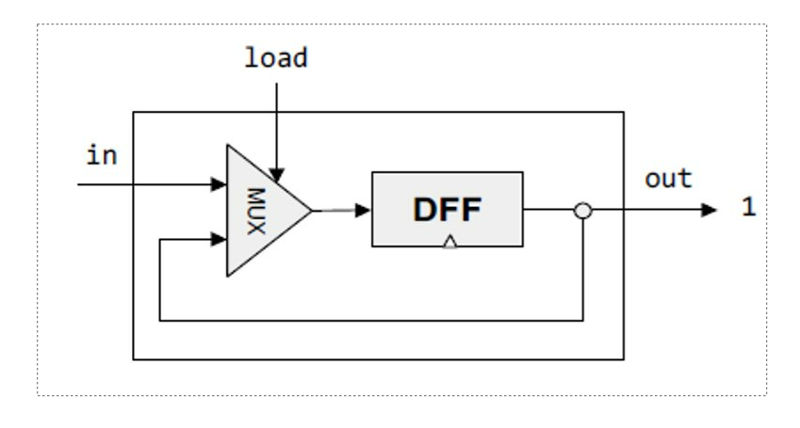
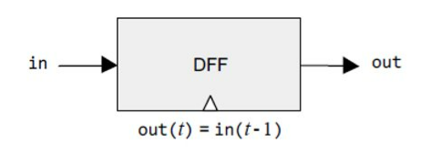
A and D register

Slide 14
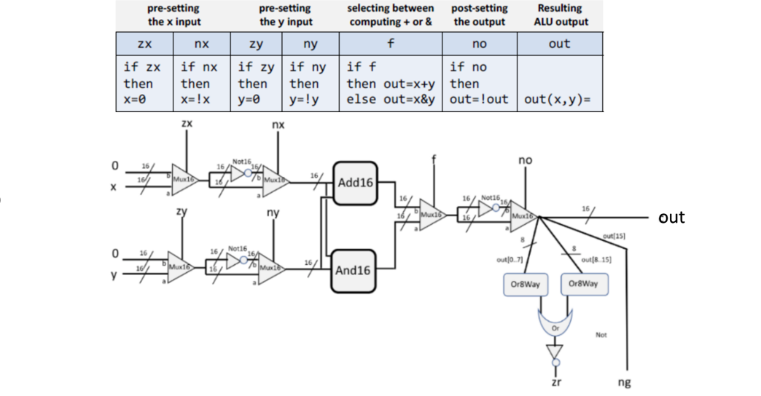
ALU

Slide 15
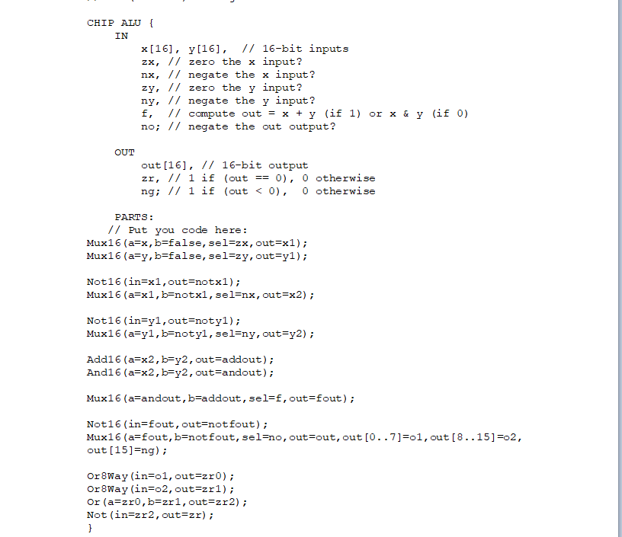
ALU

Slide 16
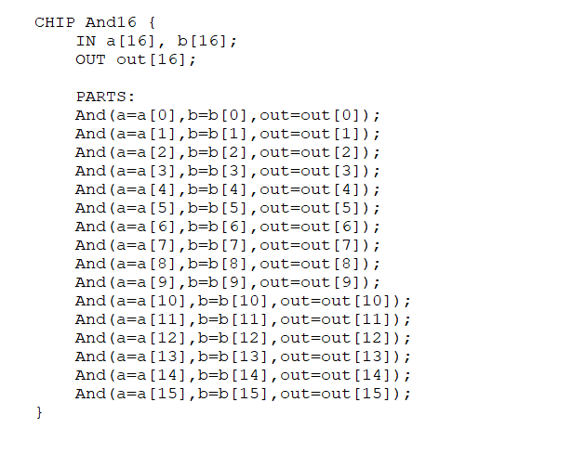
And16

Slide 17
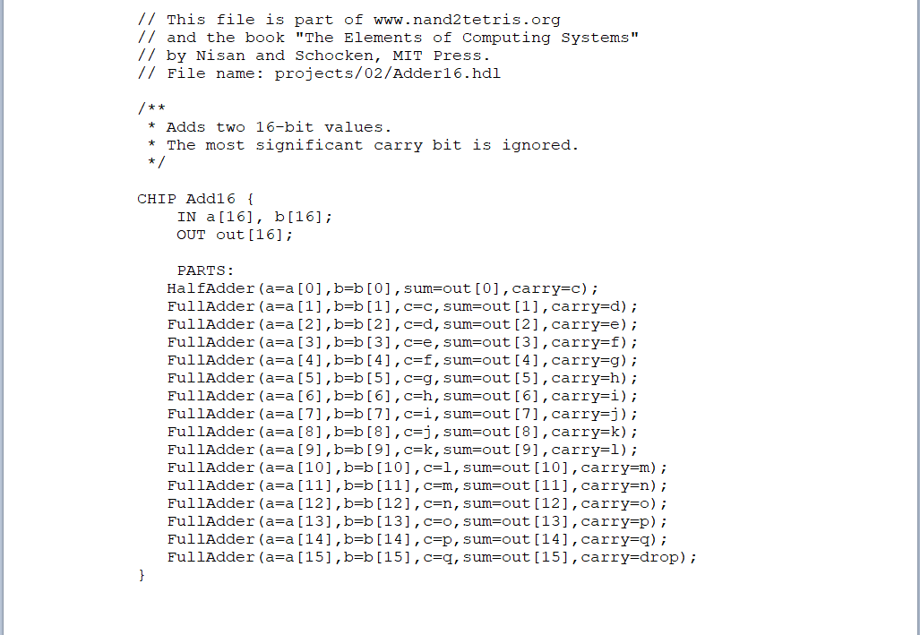
Add 16

Slide 18
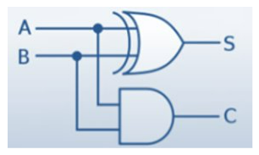
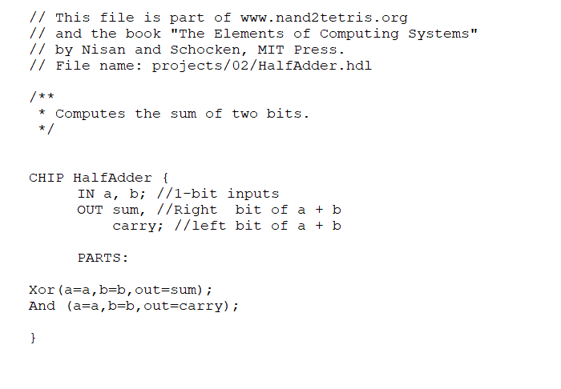
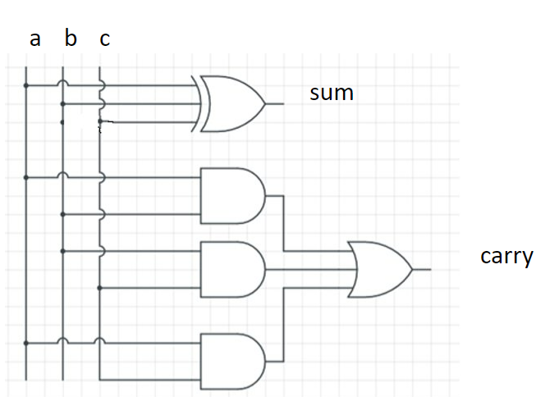
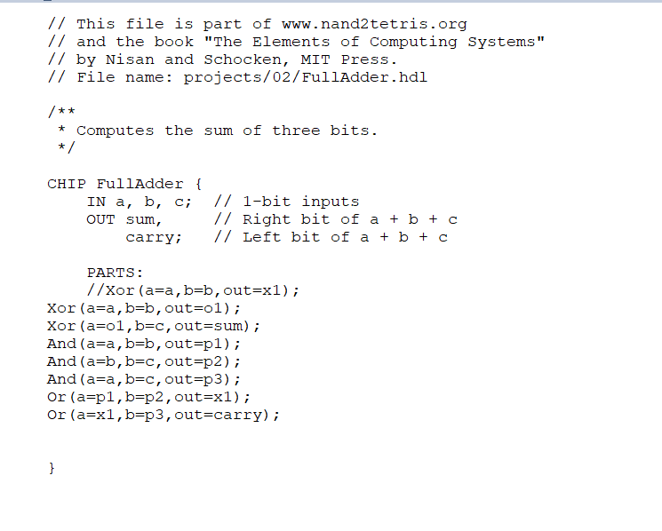
Half adder
Full adder

Slide 19
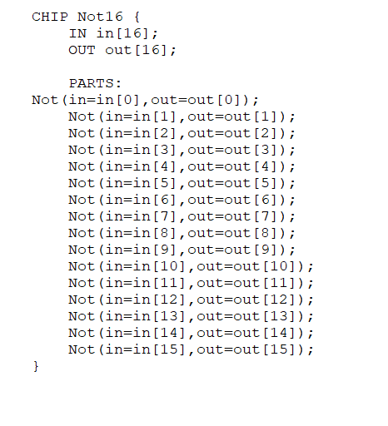
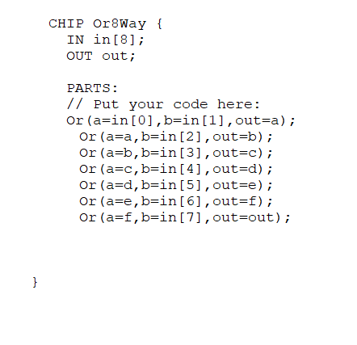
Or 8 way
Not 16

Slide 20
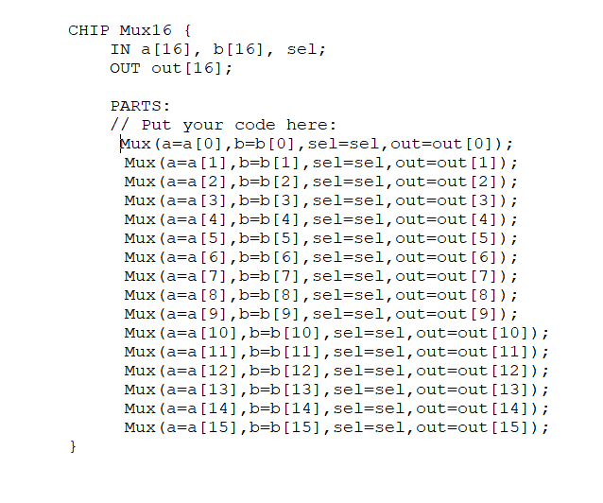
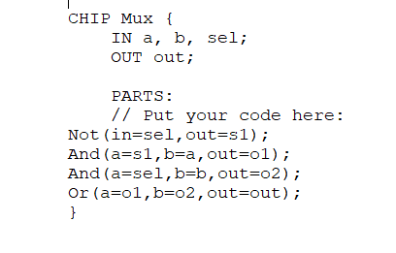
Mux 16
2 ---> 1 Mux

Slide 21
CPU HDL file

Slide 22
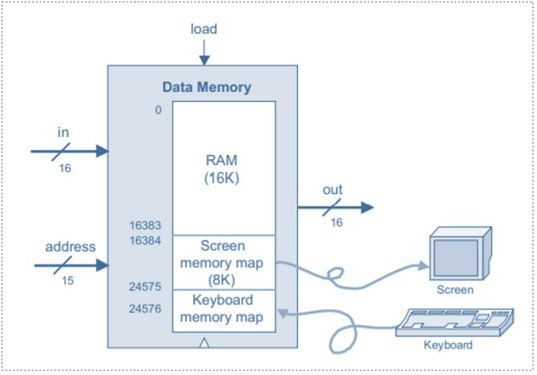
Data memory

Slide 23
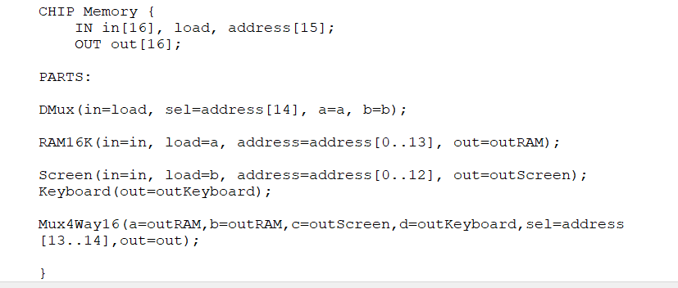
Data memory HDL file

Slide 24
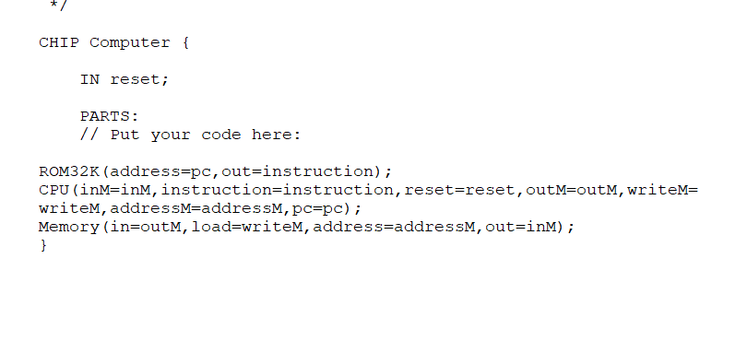
Hack computer HDL file

Slide 25
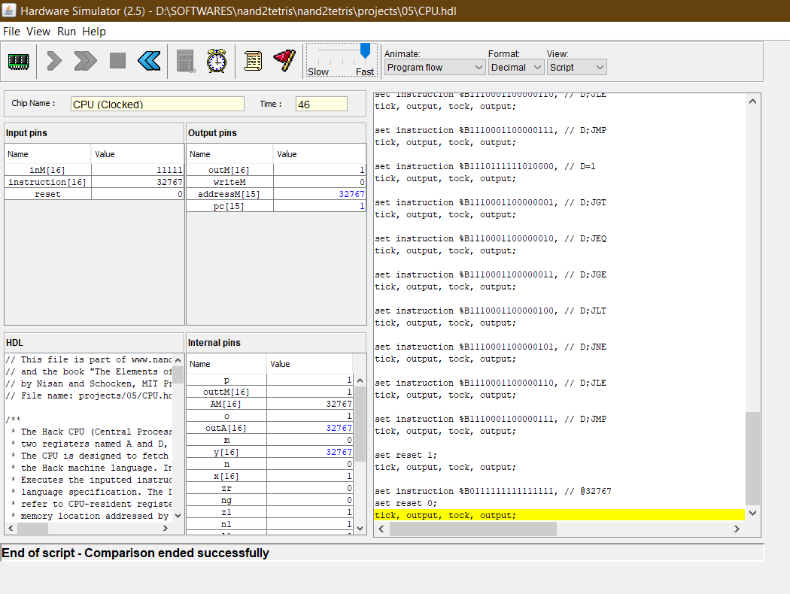
CPU in Hardware Simulator

Slide 26
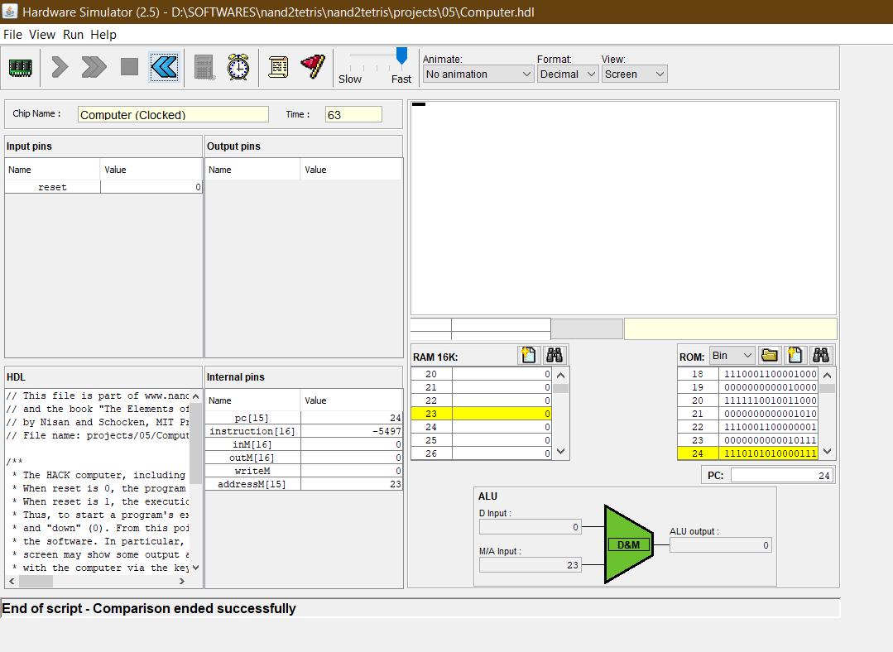
Computer .hdl file in hardware simulator
Tested with a rect -external.tst file

Slide 27
B
16 bit Carry look-ahead adder

Slide 28

Part B
Design and implement 16-bit parallel adder/subtractor ( a circuit which performs both operations.

Slide 29
Basic gates implementation using NAND gates :
And
Or
Xor

Slide 30
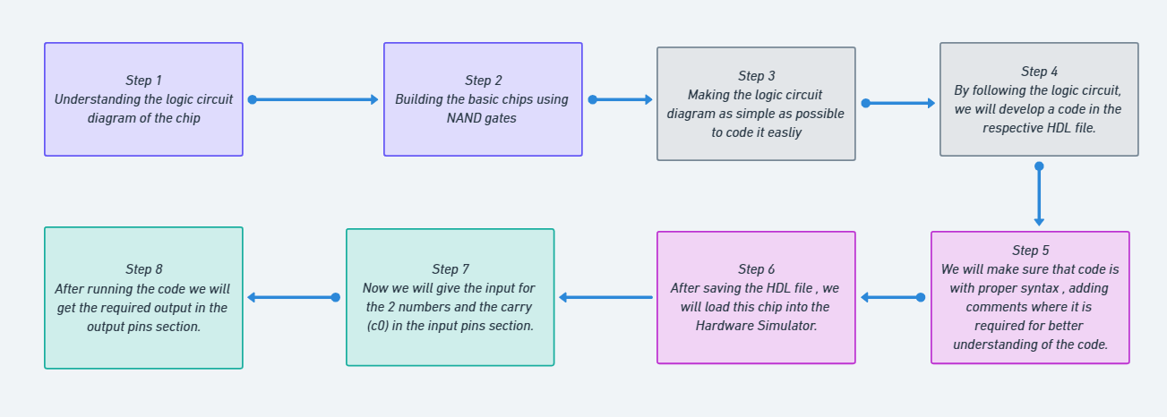
Steps to do…….

Slide 31
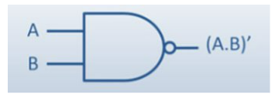
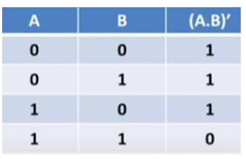
Nand gate :
Truth table

Slide 32
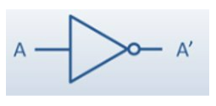
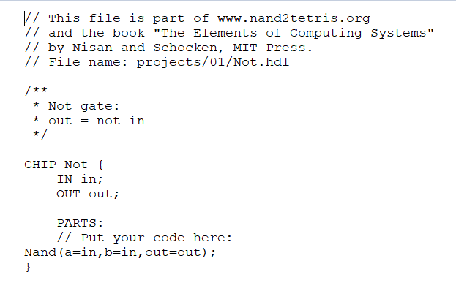
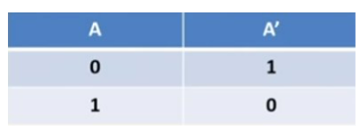
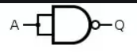
Not gate:
Truth table
HDL FILE

Slide 33
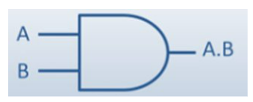
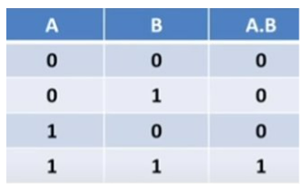
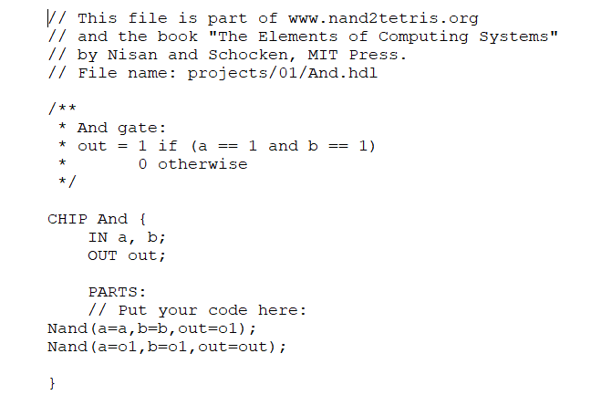
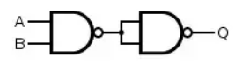
And gate :
Truth table
HDL FILE

Slide 34
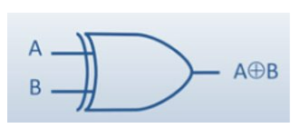
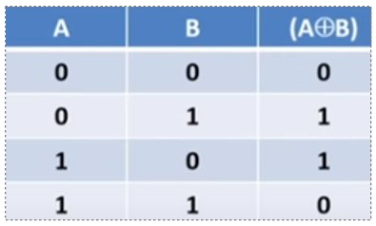
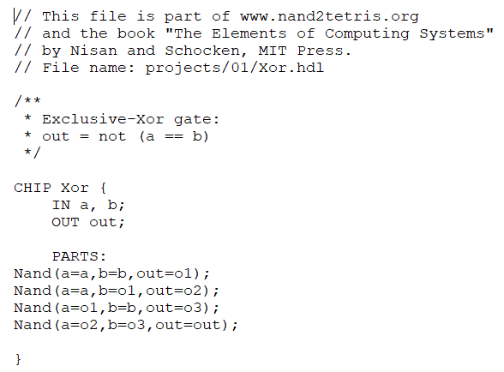
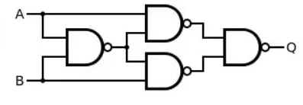
Xor gate
Truth Table
HDL FILE

Slide 35
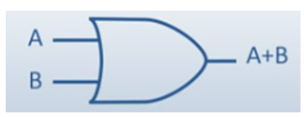
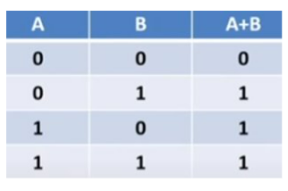
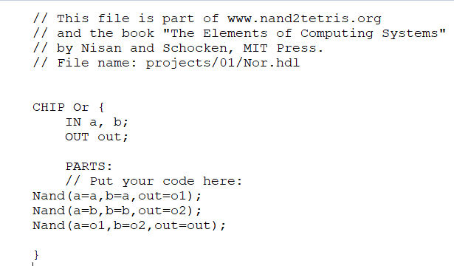
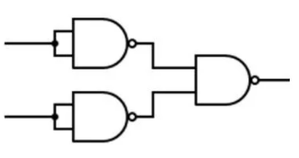
Or gate
Truth table
HDL FILE

Slide 36
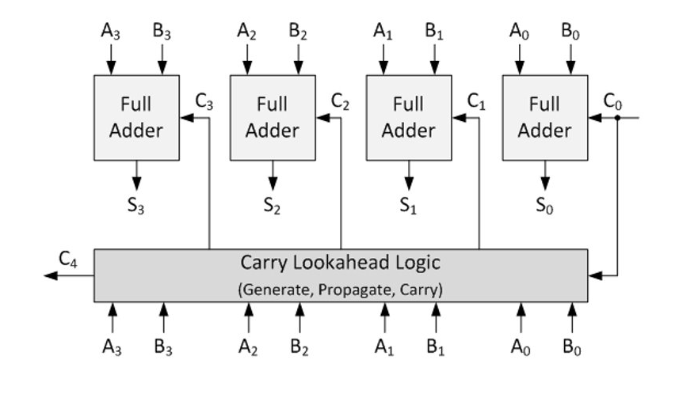
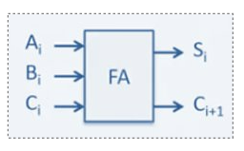
Circuit diagram for a Carry-lookahead adder:
Full adder

Slide 37

Carry lookahead logic:

Slide 38



By seeing the logic circuit we have to find the carry by using carry ahead logic So we will find Gi and Pi and will evaluate the carry. Like this we will do for each 16 bit After finding carry we will find the final sum using the below formula

Slide 39


16 bit parallel adder HDL file

Slide 40


Carry generating …
Example :

Slide 41

Sum generating.…

Slide 42

Example 1

Slide 43

Binary form….

Slide 44

Example 2

Slide 45

Binary form…

Slide 46

Example 3

Slide 47

Example 4

Slide 48
THANK YOU

